Slide 1
Python Programming Language:History
In 1987, Guido worked on a big distributed operating system the dutch CWI, a national research institute for mathematics and computer science in the Netherlands.
Within that project, he had some freedom to work on side-projects. So, armed with the knowledge and experience he had built up in the years before, working on a computer language called ABC, he started writing the Python programming language.

Slide 2
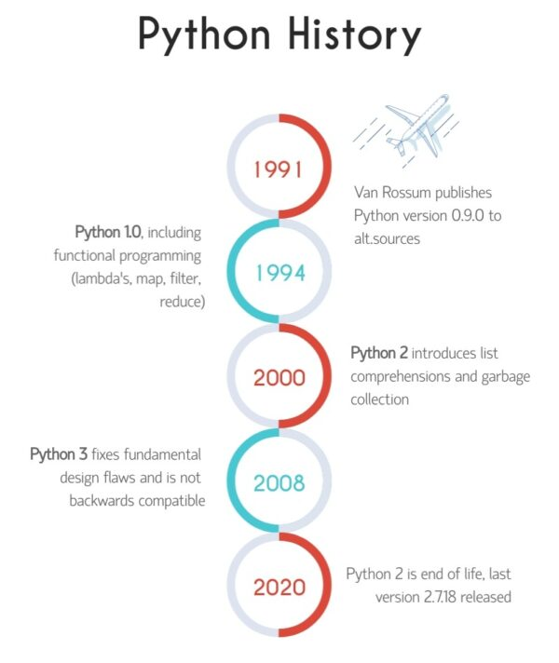

Slide 3
Python Features
Python provides many useful features which make it popular and valuable from the other programming languages. It supports object-oriented programming, procedural programming approaches and provides dynamic memory allocation. We have listed below a few essential features.
1) Easy to Learn and Use
Python is easy to learn as compared to other programming languages. Its syntax is straightforward and much the same as the English language. There is no use of the semicolon or curly-bracket, the indentation defines the code block. It is the recommended programming language for beginners.
2) Expressive Language
Python can perform complex tasks using a few lines of code.
A simple example, the hello world program you simply type print("Hello World").
It will take only one line to execute, while Java or C takes multiple lines.
3) Interpreted Language
Python is an interpreted language it means the Python program is executed one line at a time. The advantage of being interpreted language, it makes debugging easy and portable.

Slide 4
Contd..
4) Cross-platform Language
Python can run equally on different platforms such as Windows, Linux, UNIX, and Macintosh, etc. So, we can say that Python is a portable language. It enables programmers to develop the software for several competing platforms by writing a program only once.
5) Free and Open Source
Python is freely available for everyone. It is freely available on its official website
www.python.org
It has a large community across the world that is dedicatedly working towards make new python modules and functions. Anyone can contribute to the Python community. The open-source means, "Anyone can download its source code without paying any penny."
6) Object-Oriented Language:
Python supports object-oriented language and concepts of classes and objects come into existence. It supports inheritance, polymorphism, and encapsulation, etc. The object-oriented procedure helps to programmer to write reusable code and develop applications in less code.

Slide 5
Contd….
7) Extensible:
It implies that other languages such as C/C++ can be used to compile the code and thus it can be used further in our Python code. It converts the program into byte code, and any platform can use that byte code.
8) Large Standard Library:
It provides a vast range of libraries for the various fields such as machine learning, web developer, and also for the scripting. There are various machine learning libraries, such as Tensor flow, Pandas, Numpy, Keras, and Pytorch, etc.
Django, flask, pyramids are the popular framework for Python web development.

Slide 6
Contd..
9) GUI Programming Support
Graphical User Interface is used for the developing Desktop application.
PyQT5, Tkinter, Kivy are the libraries which are used for developing the web application.
10) Integrated
It can be easily integrated with languages like C, C++, and JAVA, etc. Python runs code line by line like C,C++ Java. It makes easy to debug the code.
11. Embeddable
The code of the other programming language can use in the Python source code. We can use Python source code in another programming language as well. It can embed other language into our code.

Slide 7
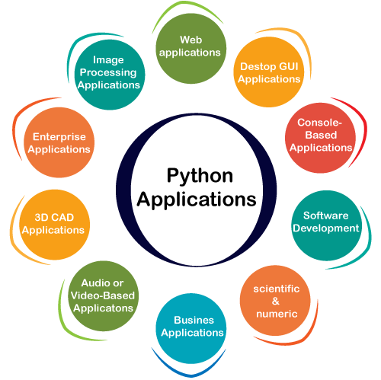
Applications of python

Slide 8
Contd…….
1) Web Applications
We can use Python to develop web applications. It provides libraries to handle internet protocols such as HTML and XML, JSON, Email processing, request, beautiful Soup, Feedparser, etc.
One of Python web-framework named Django is used on Instagram.
Python provides many useful frameworks, and these are given below:
Django and Pyramid framework(Use for heavy applications)
Flask and Bottle (Micro-framework)
Plone and Django CMS (Advance Content management)

Slide 9
Applications contd…
2) Desktop GUI Applications
The GUI stands for the Graphical User Interface, which provides a smooth interaction to any application. Python provides a Tk GUI library to develop a user interface. Some popular GUI libraries are given below.
Tkinter or Tk
wxWidgetM
Kivy (used for writing multitouch applications )
PyQt or Pysid

Slide 10
Contd..
3) Console-based Application
Console-based applications run from the command-line or shell. These applications are computer program which are used commands to execute.
This kind of application was more popular in the old generation of computers.
Python can develop this kind of application very effectively.
It is famous for having REPL, which means the Read-Eval-Print Loop that makes
it the most suitable language for the command-line applications.
Python provides many free library or module which helps to build the command-line apps. The necessary IO libraries are used to read and write. It helps to parse argument and create console help text out-of-the-box. There are also advance libraries that can develop independent console apps.

Slide 11
4.Business Applications
Business Applications differ from standard applications.
E-commerce and ERP are an example of a business application.
This kind of application requires extensively, scalability and readability, and Python provides all these features.
Oddo is an example of the all-in-one Python-based application which offers a range of business applications.
Python provides a Tryton platform which is used to develop the business application.
5.Audio or Video-based Applications
Python is flexible to perform multiple tasks and can be used to create multimedia applications.
Some multimedia applications which are made by using Python are TimPlayer, cplay, etc.

Slide 12
Python Distributions
A Python distribution is a software bundle, which contains a Python interpreter and the Python standard library. Installer programs for common operating systems are a frequent mode of distribution. Many Python distributions also have package managers so that you can install or upgrade various Python packages.
Some of the most popular distributions are listed below. Distributions which are marked as “scientific” are ones which come with IPython, numpy, pandas, and matplotlib, at a minimum.
All of the distributions provide at least one integrated development environment (IDE) for free.
A Python IDE provides a Python-aware code editor integrated with the ability to run code from that editor.

Slide 13
Python Version List
Python programming language is being updated regularly with new features and supports. There are lots of update in Python versions, started from 1994 to current release.

Slide 14
Python Version Released Date
Python 1.0 January 1994
Python 1.5 December 31, 1997
Python 1.6 September 5, 2000
Python 2.0 October 16, 2000
Python 2.1 April 17, 2001
Python 2.2 December 21, 2001
Python 2.3 July 29, 2003
Python 2.4 November 30, 2004
Python 2.5 September 19, 2006
Python 2.6 October 1, 2008
Python 2.7 July 3, 2010
Python 3.0 December 3, 2008
Python 3.1 June 27, 2009
Python 3.2 February 20, 2011
Python 3.3 September 29, 2012
Python 3.4 March 16, 2014
Python 3.5 September 13, 2015
Python 3.6 December 23, 2016
Python 3.7 June 27, 2018
Python 3.8 October 14, 201

Slide 15
Python IDEs
What Are IDEs and Code Editors?
An IDE (or Integrated Development Environment) is a program dedicated to software development. As the name implies, IDEs integrate several tools specifically designed for software development. These tools usually include:
An editor designed to handle code (with, for example, syntax highlighting and auto-completion)
Build, execution, and debugging tools
Some form of source control
Most IDEs support many different programming languages and contain many more features. They can, therefore, be large and take time to download and install. You may also need advanced knowledge to use them properly.
In contrast, a dedicated code editor can be as simple as a text editor with syntax highlighting and code formatting capabilities.
Most good code editors can execute code and control a debugger. The very best ones interact with source control systems as well. Compared to an IDE, a good dedicated code editor is usually smaller and quicker, but often less feature rich.

Slide 16
Contd..
PyCharm
Category: IDE
Website: https://www.jetbrains.com/pycharm/
One of the best (and only) full-featured, dedicated IDEs for Python is PyCharm. Available in both paid (Professional) and free open-source (Community) editions, PyCharm installs quickly and easily on Windows, Mac OS X, and Linux platforms.
Out of the box, PyCharm supports Python development directly. You can just open a new file and start writing code. You can run and debug Python directly inside PyCharm, and it has support for source control and projects.
PyCharm IDE for Python
Pros: It’s the de facto Python IDE environment, with tons of support and a supportive community. It edits, runs, and debugs Python out of the box.
Cons: PyCharm can be slow to load, and the default settings may need tweaking for existing projects.

Slide 17
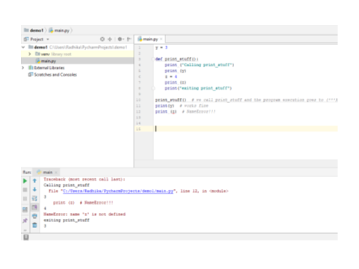

Slide 18
Cont…..
Spyder
Category: IDE
Website: https://github.com/spyder-ide/spyder
Spyder is an open-source Python IDE that’s optimized for data science workflows. Spyder comes included with the Anaconda package manager distribution, so depending on your setup you may already have it installed on your machine.
What’s interesting about Spyder is that it’s target audience is data scientists using Python. You’ll notice this throughout. For example, Spyder integrates well with common Python data science libraries like SciPy, NumPy, and Matplotlib.
Spyder features most of the “common IDE features” you might expect, such as a code editor with robust syntax highlighting, Python code completion, and even an integrated documentation browser.
A special feature that I haven’t seen in other Python editing environments is Spyder’s “variable explorer” that allows you to display data using a table-based layout right inside your IDE. Personally, I usually don’t have a need for this but it does look neat. If you regularly do data science work using Python, you might fall in love with this unique feature. The IPython/Jupyter integration is nice as well.
Overall, I’d say that Spyder feels more basic than other IDEs. I like to view it more as a special purpose tool rather than something I use as my primary editing environment every day. What is nice about this Python IDE is that it is available for free on Windows, macOS, and Linux and that it is fully open-source software.
Spyder Python IDE Screenshot
Pros: You’re a data scientist using the Anaconda Python distribution.
Cons: More experienced Python developers might find Spyder too basic to work with on a daily basis and instead opt for a more complete IDE or customized editor solution.
Thonny

Slide 19
Contd…
Thonny
Category: IDE
Website: http://thonny.org/
A recent addition to the Python IDE family, Thonny is billed as an IDE for beginners. Written and maintained by the Institute of Computer Science at the University of Tartu in Estonia, Thonny is available for all major platforms, with installation instructions on the site.
By default, Thonny installs with its own bundled version of Python, so you don’t need to install anything else new. More experienced users may need to tweak this setting so already installed libraries are found and used.
Thonny IDE for beginners

